Slide 1
Monday 25th November 2024 LO: I can research and describe the human and physical Geography of Iceland

Slide 2
Recap
Physical geography is about the natural environment of a place, e.g. volcanoes, rivers etc.
Human geography is about the presence of people and how the way in which they live interacts with the natural environment. E.g. they build towns and cities, create farms and fish in the oceans.

Slide 3
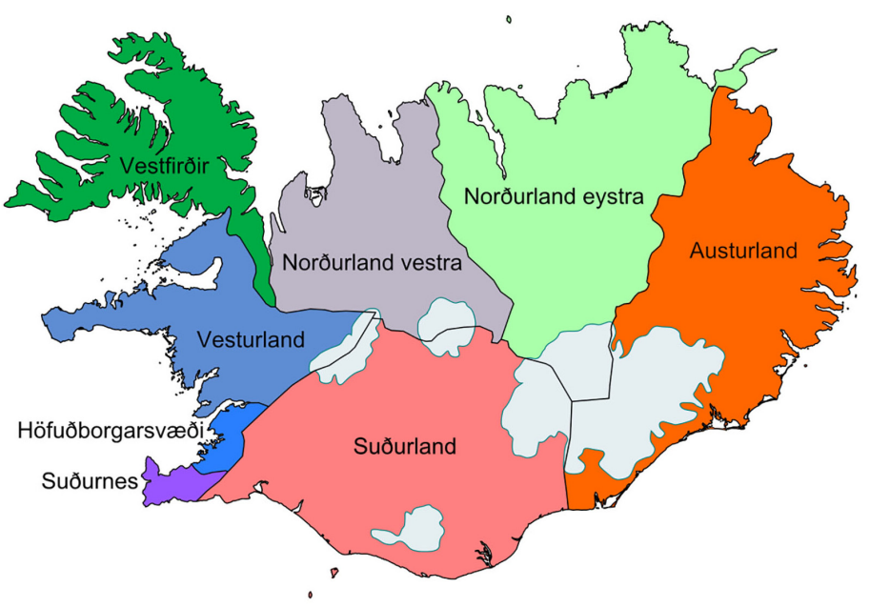
This map shows the regions of Iceland.

Slide 4
You’re now going to use the given sources to research the geographical characteristics of a region and make notes on it.
You only need to pick one, though can do more if you wish. Later in the term, we will be writing a persuasive leaflet encouraging people to visit Iceland, so focus mainly on reasons to go.

Slide 5
https://www.visiticeland.com/the-regions/
If you can't access the Internet all day, then a research page for each region has been uploaded alongside this presentation.

Slide 6
What did you find out? If you were planning a trip to Iceland, which region would you like to visit first and why?

